Slide 1
Micro-Credit Defaulter Project
Submitted by
HARIHARA SUDHAN

Slide 2
ACKNOWLEDGEMENT
Thanks for giving me the opportunity to work in FlipRobo Technologies as Intern and would like to express my gratitude to Data Trained Institute as well for trained me in Data Science Domain. This helps me to do my projects well and understand the concepts.
Dataset – FlipRobo Tech
Resources used – Google, GitHub, Blogs for conceptual referring.

Slide 3
Business Problem
A Microfinance Institution (MFI) is an organization that offers financial services to low-income populations.
MFS becomes very useful when targeting especially the unbanked poor families living in remote areas with not much sources of income.
It is widely accepted as a poverty-reduction tool, representing $70 billion in outstanding loans and a global outreach of 200 million clients.
The client wants some predictions that could help them in further investment and improvement in selection of customers for the credit.

Slide 4
Conceptual Background of the Domain Problem
Many microfinance institutions (MFI), experts and donors are supporting the idea of using mobile financial services (MFS) which they feel are more convenient and efficient, and cost saving, than the traditional high-touch model used since long for the purpose of delivering microfinance services. They are collaborating with an MFI to provide micro-credit on mobile balances to be paid back in 5 days. The Consumer is believed to be defaulter if he deviates from the path of paying back the loaned amount within the time duration of 5 days. For the loan amount of 5 (in Indonesian Rupiah), payback amount should be 6 (in Indonesian Rupiah), while, for the loan amount of 10 (in Indonesian Rupiah), the payback amount should be 12 (in Indonesian Rupiah). This problem contains data of customers who is defaulter / Non – defaulters and has the main account and data account recharge and total amount of sum amount and its frequency. So, we need to predict for each loan transaction, whether the customer will be paying back the loaned amount within 5 days of insurance of loan.

Slide 5
Review of Literature
We are going to work on the dataset provided for building a model to predict the nature of future customers –
Uploading the dataset
Exploratory analysis of features
Data -preprocessing, removing unnecessary features
Visualisaton of features, features along with target feature
Data cleaning by removing outliers or missing values treatment
Model pre-processing and model training
Tesing multiple algorithms with multiple evaluation metrics
Using the evaluation metrics best suited for our problem
Hyper-parameter tuning using RandomisedSearchCV for the best model parameter
Model prediction and saving the file in csv format
Saving the final model

Slide 6
Motivation for the Problem Undertaken
This project was provided to me by FlipRobo Technology as a part of internship program . This dataset helped me a lot for understanding the the real time problems with data we are going to face. It helps me in developing the skills needed for the future work.
Further diving into the dataset and understanding the current situation of my country due to covid-19 , I was highly motivated to take up this project. Seeing the current covid situation, many people are facing health emergency .In this time they need to call ambulance,police, doctors ,relatives etc but due to lack of sufficient funds they may face calling problem. But this project is based on the solution of this problem ,as some Microfinance Institution are providing small credit loans to the poor familiers in remote areas.
The objective of this project is to prepare a model which can signify the difference in defaulters and non-defaulters and helps our client in further investment and selection of customers.

Slide 7
Analytical Problem Framing
• Mathematical/ Analytical Modeling of the Problem In this case, Label ‘1’ indicates that the loan has been payed i.e., Non- defaulter, while Label ‘0’ indicates that the loan has not been payed i.e., defaulter. In the provided dataset, our target variable "label" is a categorical with two categories: " defaulter " and " Non- defaulter ". Therefore, we will be handling this modelling problem as classification.
• Data Sources and their formats
We can see that our target variable has more non-defaulters (paying loan on time) than defaulters (not paying loan on time)

Slide 8
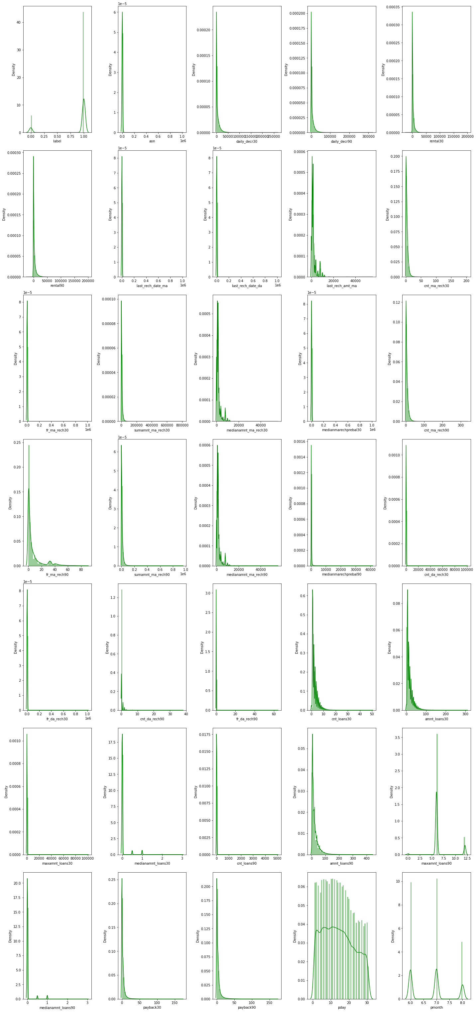
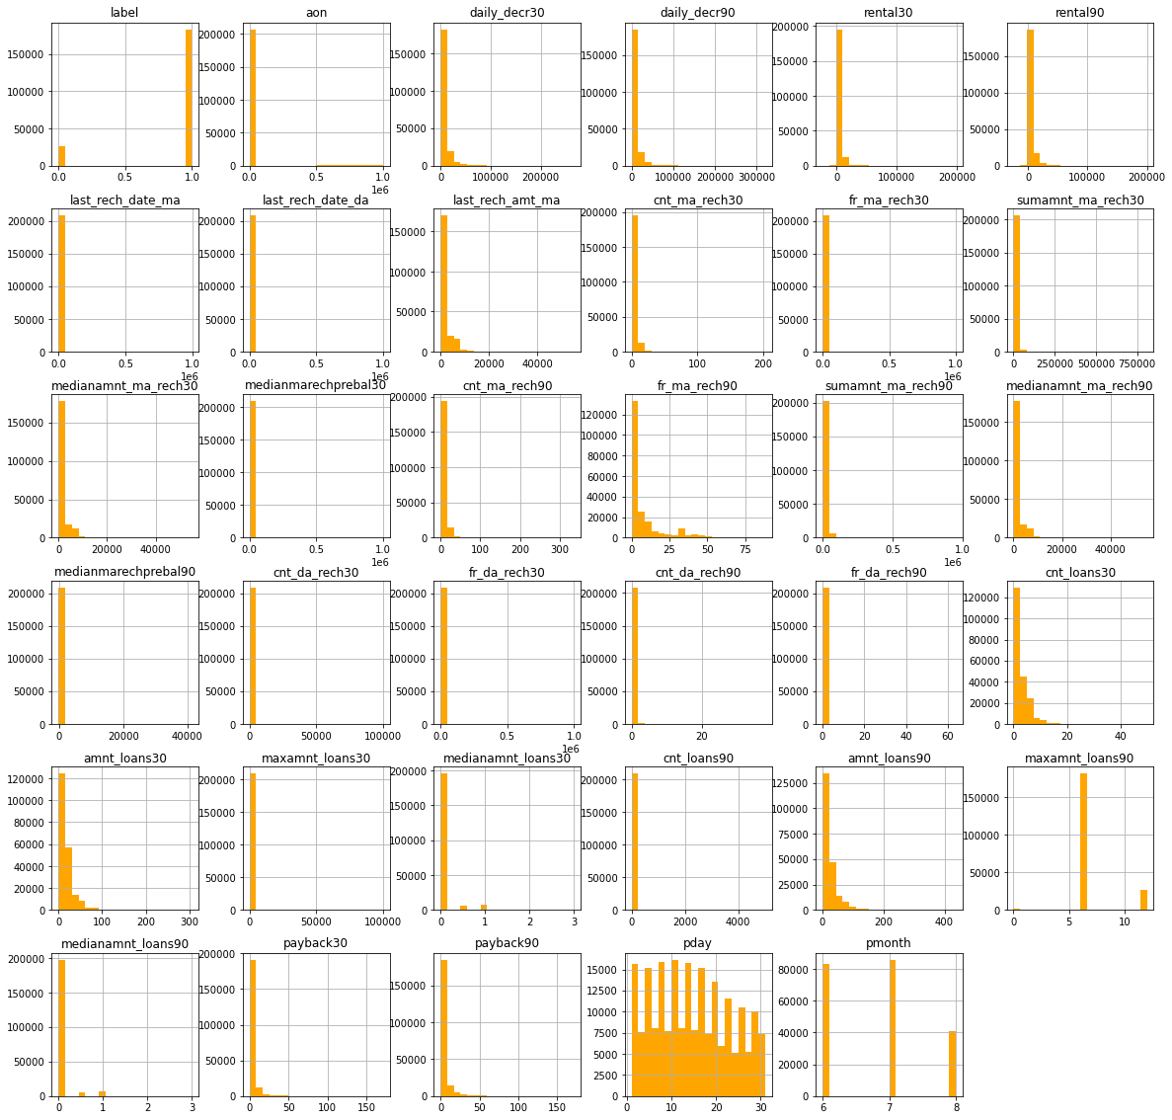
Visualisation of Data

Slide 9
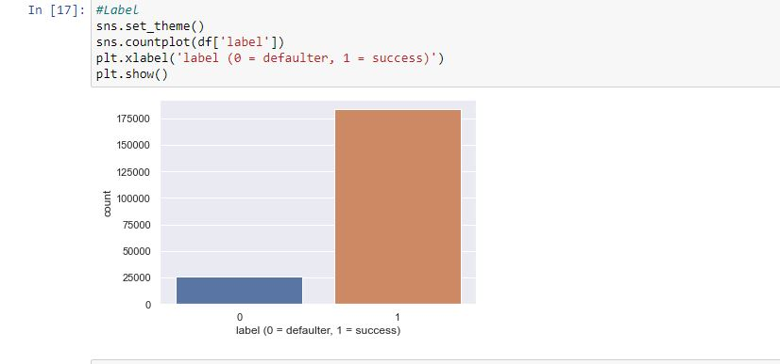
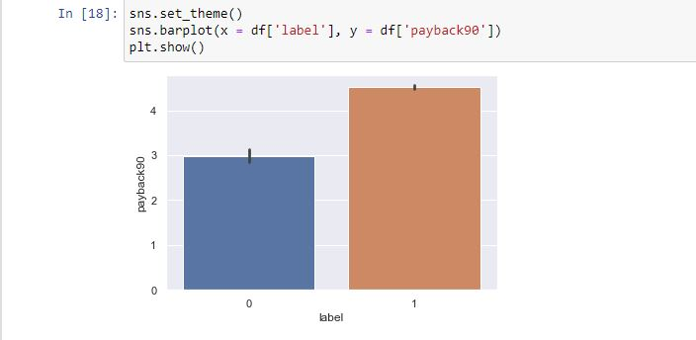
Visualisation

Slide 10
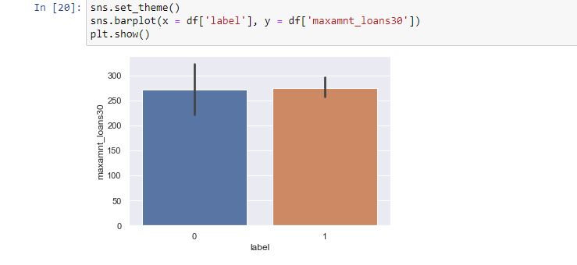
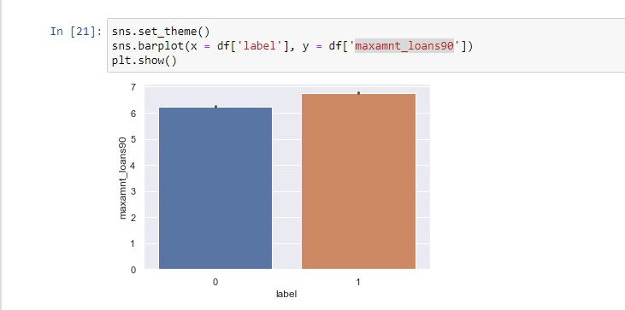
Visualisation

Slide 11
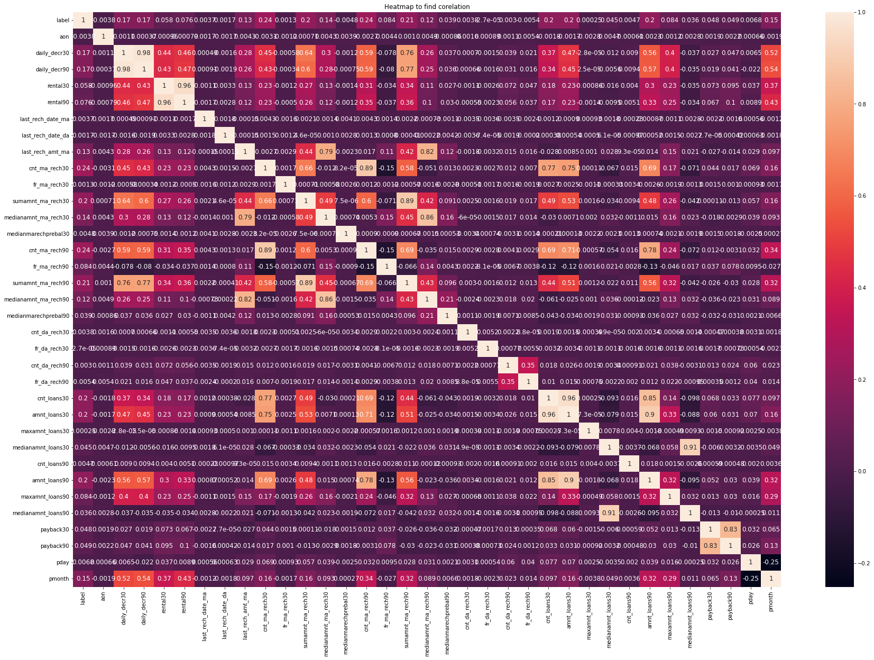
Visualisation
CORELATION using HeatMap

Slide 12
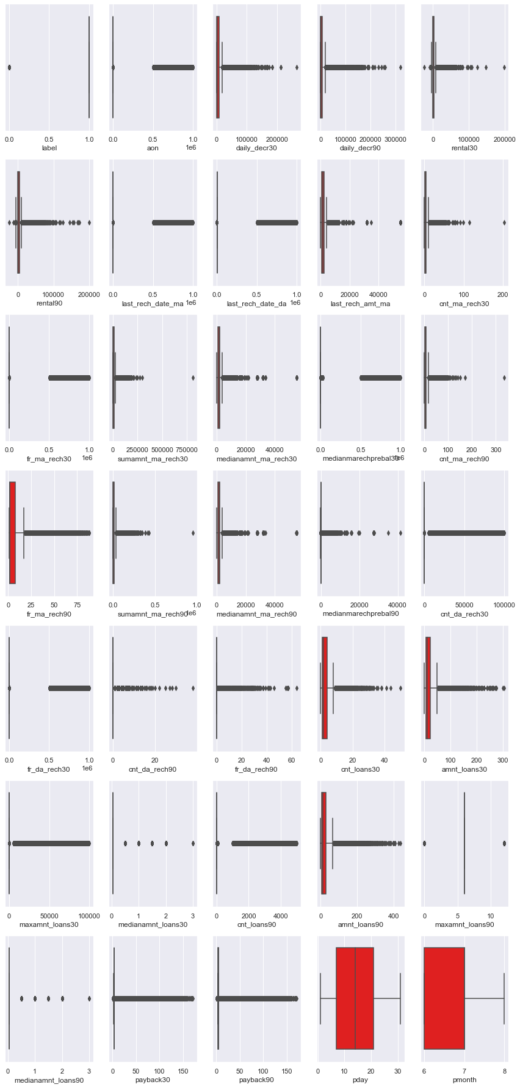
outliers

Slide 13
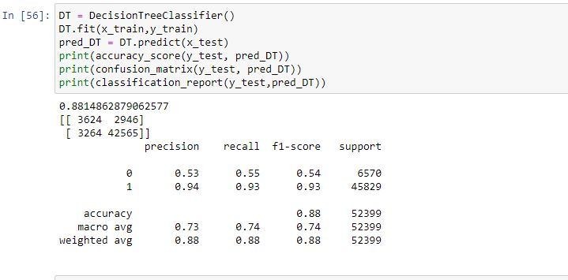
DecisionTreeClassifier

Slide 14
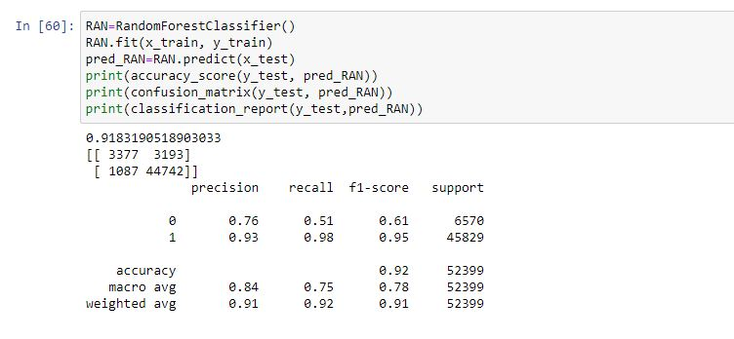
RandomForestClassifier

Slide 15
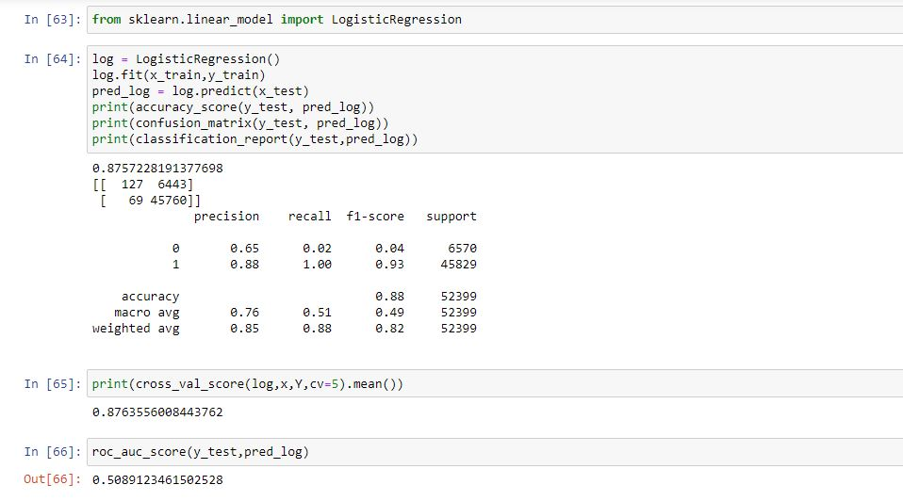
LogisticRegression

Slide 16
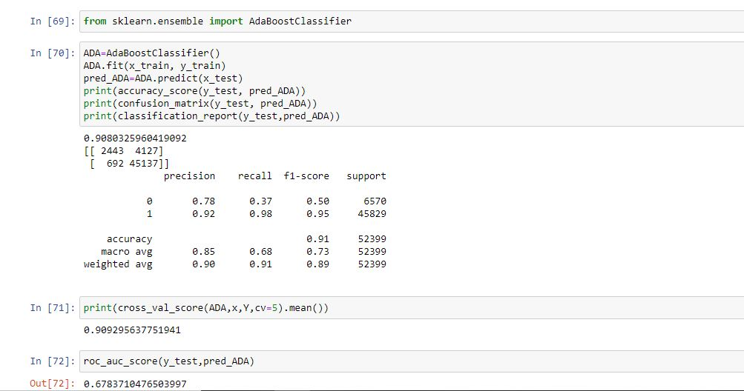
AdaBoostClassifier

Slide 17
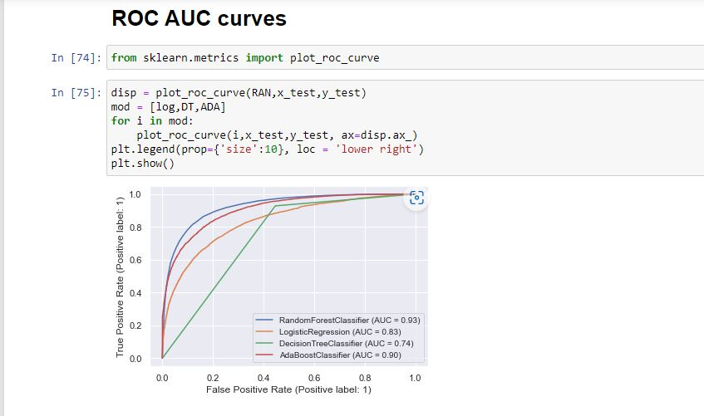
ROC Curve

Slide 18
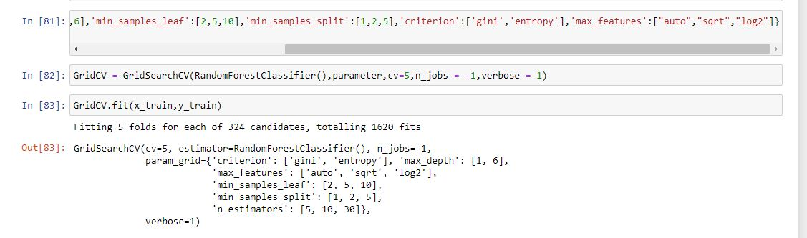
HyperParameterTuning

Slide 19
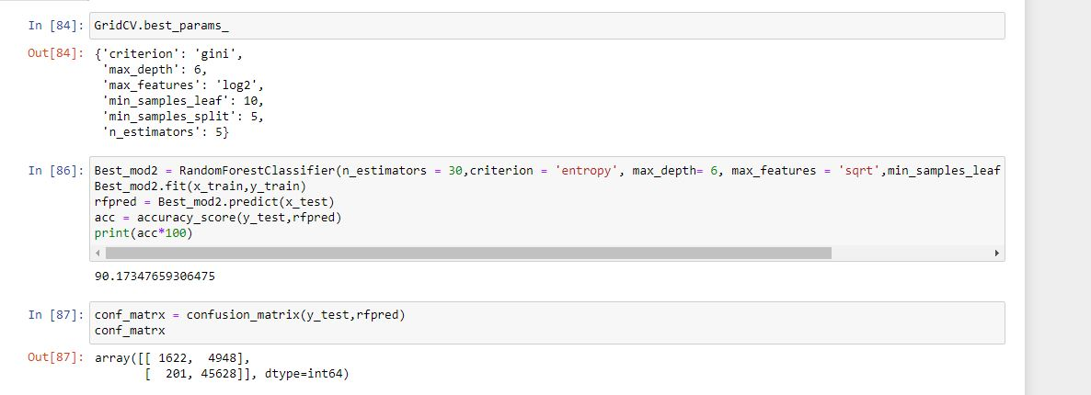
GridsearchCV

Slide 20
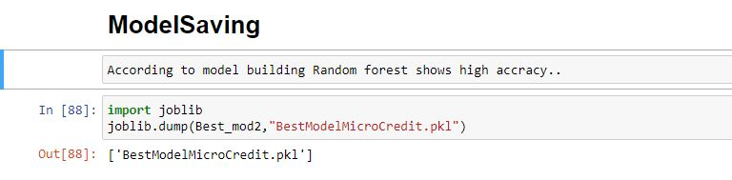
SavingModel

Slide 21
THANK YOY

